Slide 1
Credit Card Fraud Detection Using Homomorphic Encryption in ML
Meet Bhatt 202001267
Vraj Chaudhari 202003006
Jay Patel 202003019
Kunjera Shreyansh 202003031

Slide 2
Problem
Suppose you are Head of a Bank and you have hired a team of ML engineers so that you can get some insights about the data and give some results to your customers ex.
By comparing the last six months expenses to the last week’s expenses send a message to the user if there has been some unusual activities in his/her account.
It is against bank policies to give access to a user’s private data to any unauthorized person/agency.
But you can provide homomorphically encrypted customer data to any ML expert or Data Analyst , who can train an ML model on the given encrypted data and give you results related to the data.

Slide 3
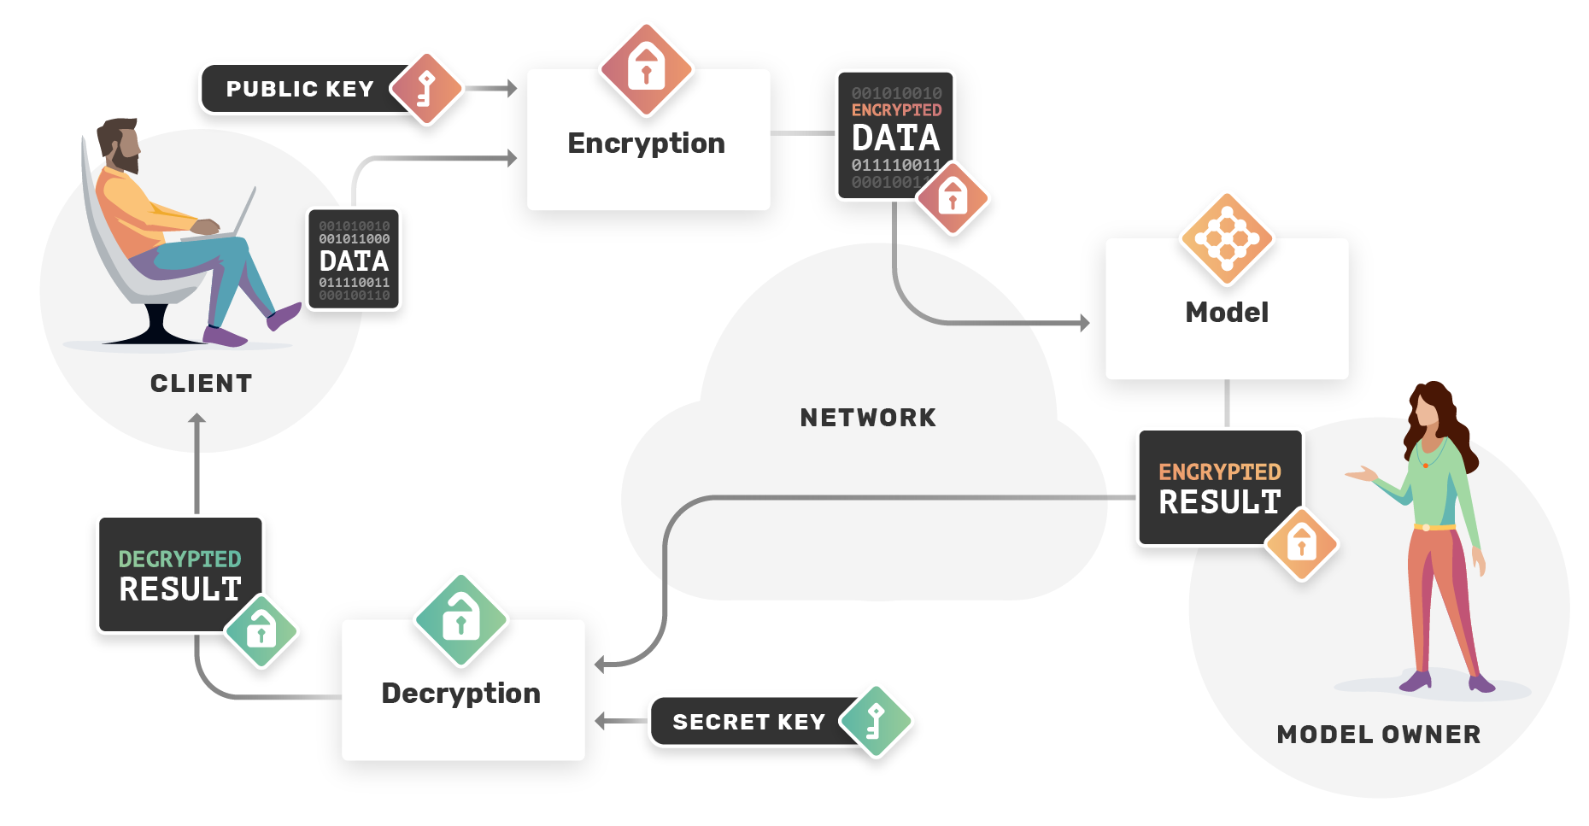
https://images.app.goo.gl/43NUw1rya54TBP7F9

Slide 4
Homomorphic Encryption
Without the need to first decrypt the data, computations can be done on it thanks to homomorphic encryption. By providing safe and private data analysis, this method has the potential to revolutionise machine learning.
Homomorphic encryption enables models to be trained on encrypted data without ever disclosing the raw data to the model owner. This is crucial when dealing with private or delicate data, like sensitive financial or medical information.
The use of homomorphic encryption in federated learning, where various parties contribute their data to train a single model without disclosing their raw data to one another, is one of the most promising uses of machine learning.

Slide 5
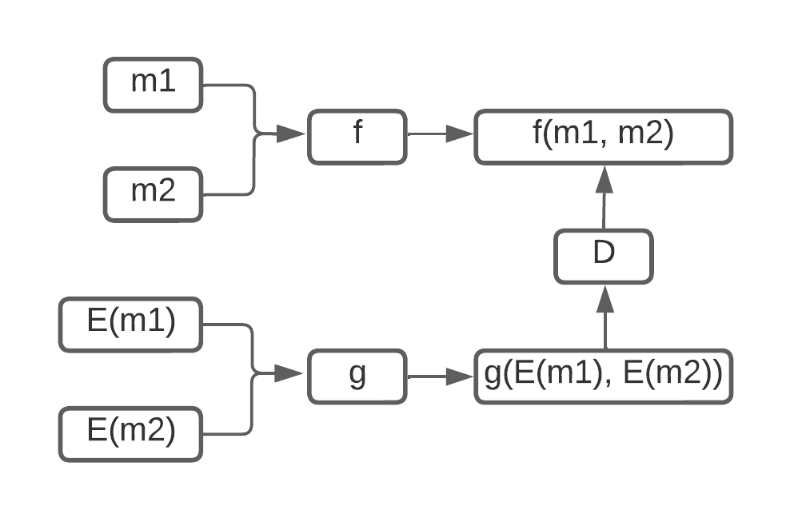

Slide 6
Microsoft TenSEAL
TenSEAL is used to perform HE operations on tensors. It is constructed on top of Microsoft Tenseal, a C++ library that implements the HE algorithms BFV and CKKS.
TenSEAL is a C++ library with a Python interface that offers simplicity through a Python API while maintaining efficiency by carrying out the majority of its operations in C++.
We have used CKKS as an encryption scheme in our code implementation.

Slide 7
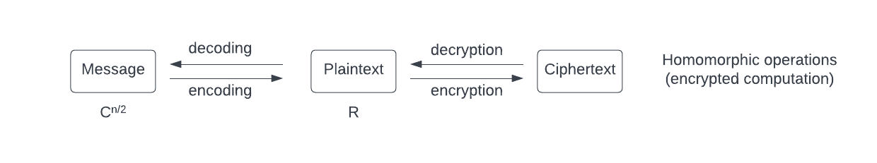
CKKS
[Cheon-Kim-Kim-Song] Homomorphic Encryption for Arithmetic of Approximate Numbers
CKKS is NOT a HE Scheme
D(E(m)) ≠ m D(ct1 * ct2) ≠ D(ct1) * D(ct2)
CKKS is an Approximate HE Scheme
D(E(m)) ≈ m D(ct1 * ct2) ≈ D(ct1) * D(ct2)

Slide 8
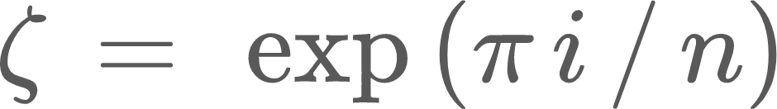
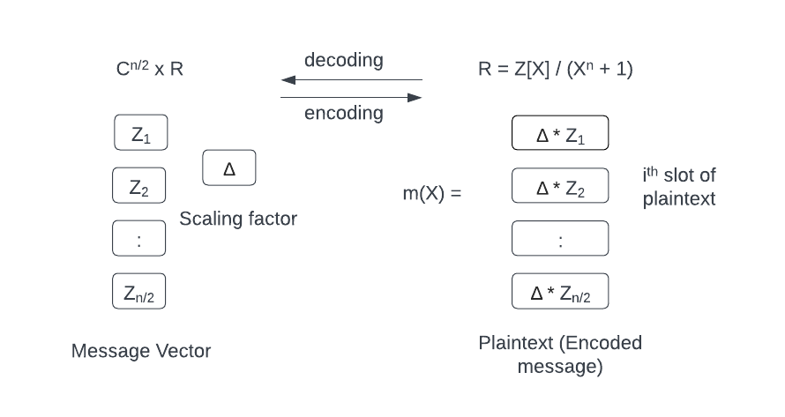

Encoding & Decoding
Canonical embedding:
Where
The precision of encoding is determined by scaling factor

Slide 9
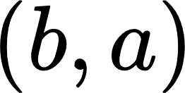
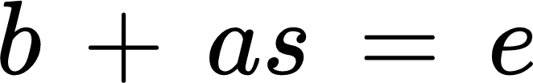
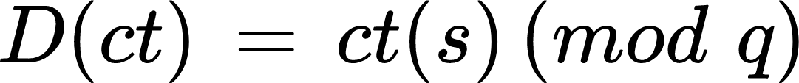
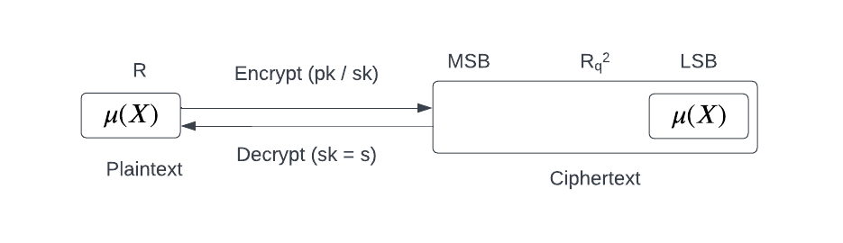
Encryption & Decryption
Enc: for a random instance s.t.
Dec:
(Approx) Correctness:
Notation:

Slide 10




Rescaling
Homomorphic ‘rounding-off’
Usually performed after multiplication
Given of scale
Compute and set its scale as
The underlying plaintext is (approximately) divided by
Plaintexts are encodings of the same message with different scaling factors

Slide 11
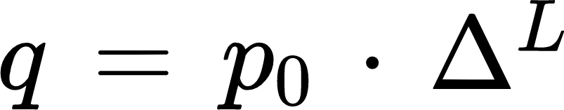
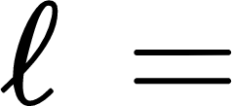

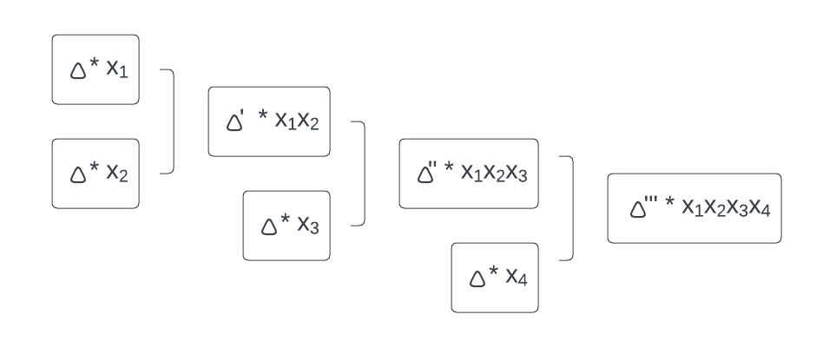
Leveled HE
Ciphertext modulus
Base modulus
Ciphertext level is Ciphertext modulus is
In below Linear Encryption circuit we will need to do (n - 1) rescaling operations for n multiplications, which not very efficient

Slide 12
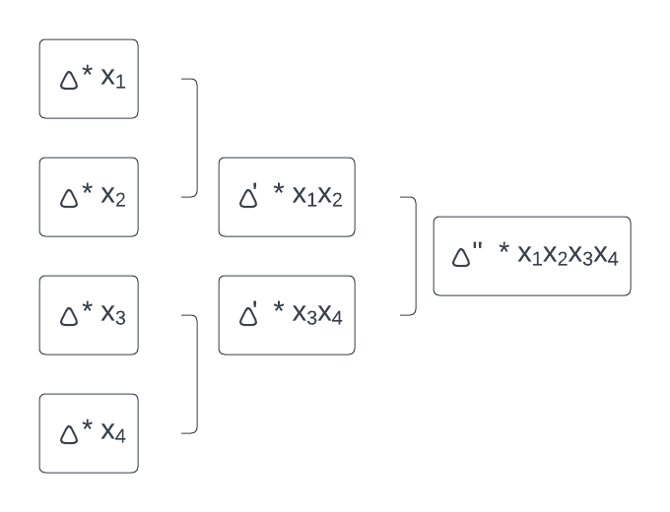
In below Tree Based encryption circuit, we will need to do (logn + 1) rescaling operations for n multiplications which is much better than than the above circuit.

Slide 13
About Dataset:
In our credit card dataset, we have total 284808 rows and 31 columns from which, only transaction and amount columns are original, all other columns are scaled due to privacy reasons.
The transactions aren't very big, really. The average of all the mounts produced is about 88.
There are only 492 instances of Fraud transactions that is 0.17%, all other transactions are Non-Fraud transactions that is 99.83%. That also means that dataset is heavily imbalanced.
Scaling has done by using PCA transformation(Dimensionality Reduction Technique).

Slide 14
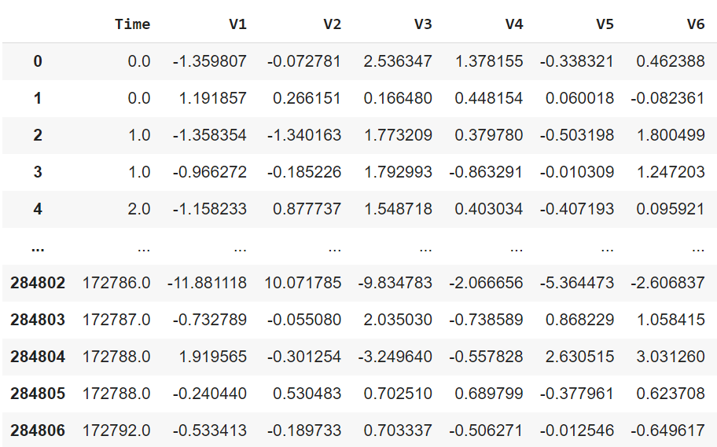
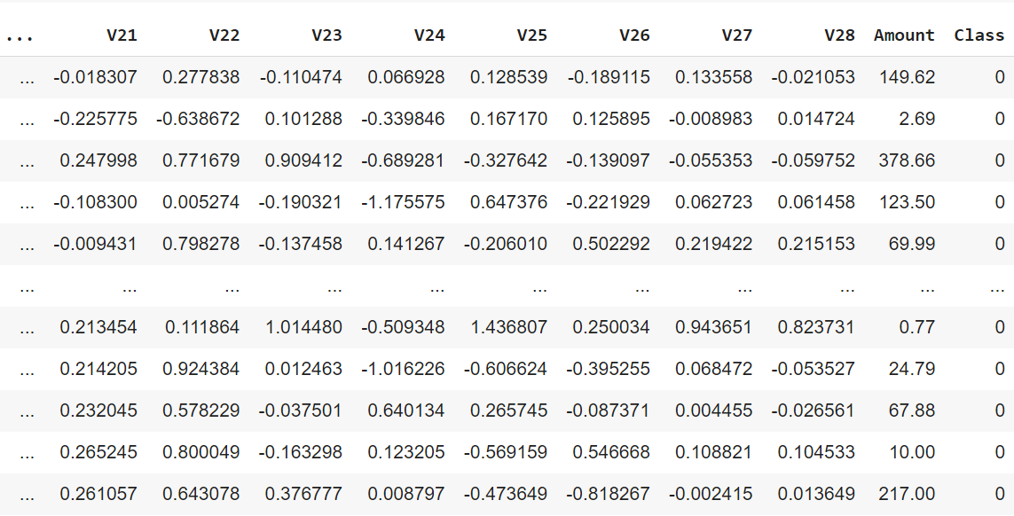

Slide 15
Preprocessing
Since our dataset is very imbalanced, if we use this dataset for model training, it will not give very accurate results and can get many errors.
Scaling:
We will first scale the column of time and amount and it should be scaled as the other columns.
Distributing:
We also need to create a sub-sample of the dataframe on which we can do model training to avoid overfitting, wrong correlations and imbalance. For that we will take 50/50 ratio of fraud and non-fraud transactions(Same amount of both class).

Slide 16
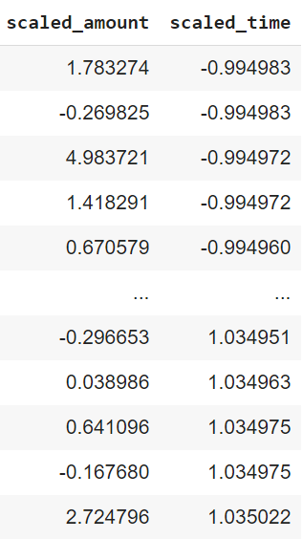
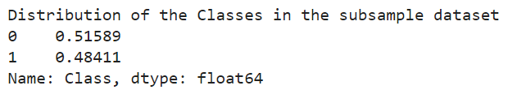

Slide 17
Preprocessing
Random Under Sampling:
To create a subsample data frame, we will use random under sampling, in which we will choose the class which have less instances and will take the same amount of instances of other class.
So we will create a new sub-sample by concat 492 cases of fraud transactions and 492 transaction of non-fraud and then will shuffle the data. Risk: Information Loss.

Slide 18
Analysis (After Preprocessing):
Correlation Matrices:
By using correlation matrices, we can observe that which features are heavily related with transaction being fraud.
We have observed that V17,V14,V12 and V10 are negatively correlated with fraud transactions so as the value of these features will be lower, the higher chance that transaction will be fraud.
We have also observed that V2,V4,V11 and V19 are positively correlated with fraud transactions so as the value of these features will be higher, the higher chance that transactions will be fraud.

Slide 19
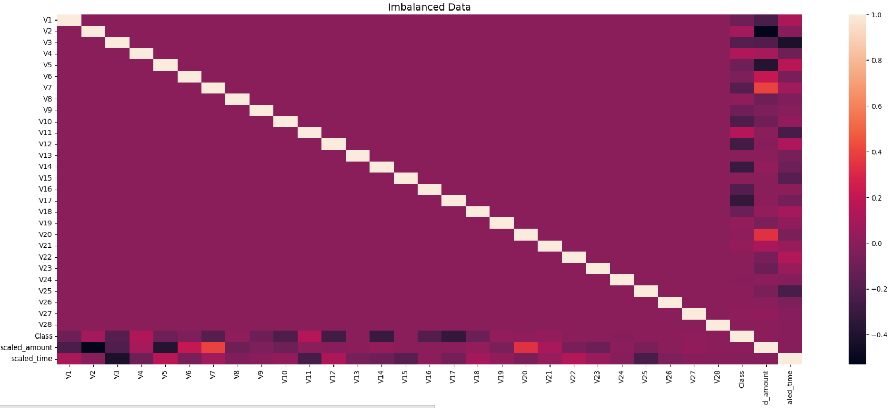

Slide 20
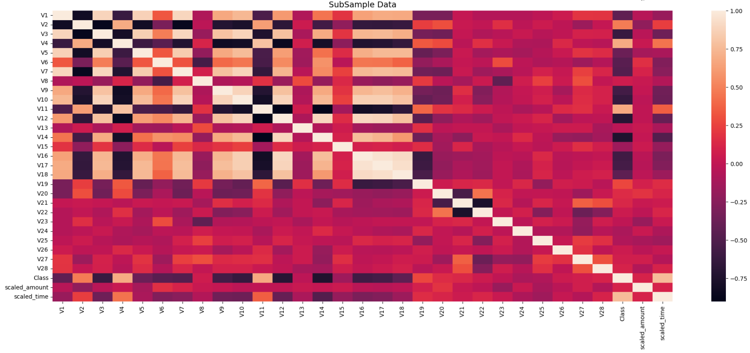

Slide 21
Analysis (After Preprocessing):
Box Plots:
Box plots help us comprehend the features and how they are distributed in both fraudulent and legitimate transactions.
Here are some of the box plots of some features with class negative and class positive correlation.

Slide 22
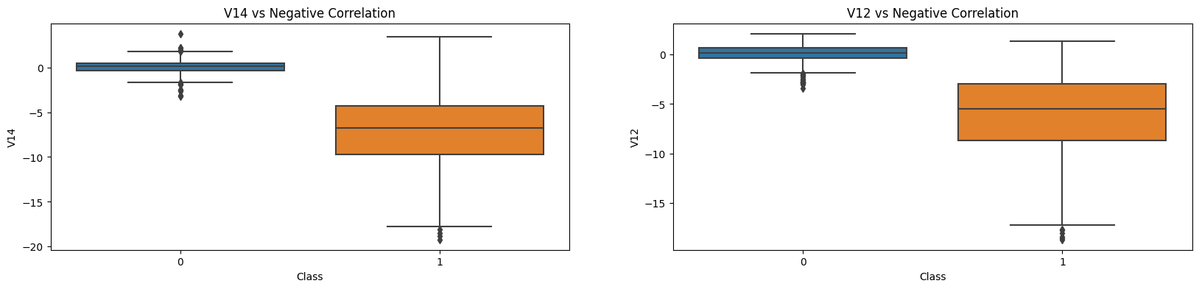

Slide 23
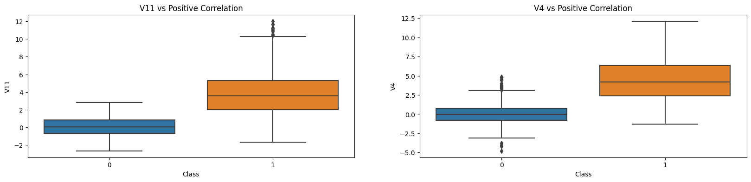

Slide 24
Analysis (After Preprocessing):
Outlier Removal:
We need to remove the “extreme outliers” from features which have very high correlation with fraud and non-fraud classes. By using this we can improve our accuracy of the model.
For this we can use IQR to calculate the 25th and 75th percentile and can remove the transactions which are beyond the 25th and 75th percentile as an extreme outliers.

Slide 25
Analysis (After Preprocessing):
Tradeoff:
Tradeoff is that we must be careful when deciding how far to raise the outlier removal threshold. The threshold is calculated by multiplying a value (for example, 1.5) by the interquartile range. If this threshold is multiplied by a larger value, such as three, it will discover fewer outliers; conversely, if this threshold is lower, it will detect more outliers and if it will detect more outliers, it might be risky because by doing that we can also lose some important informations which will cause our models to have a lower accuracy.

Slide 26
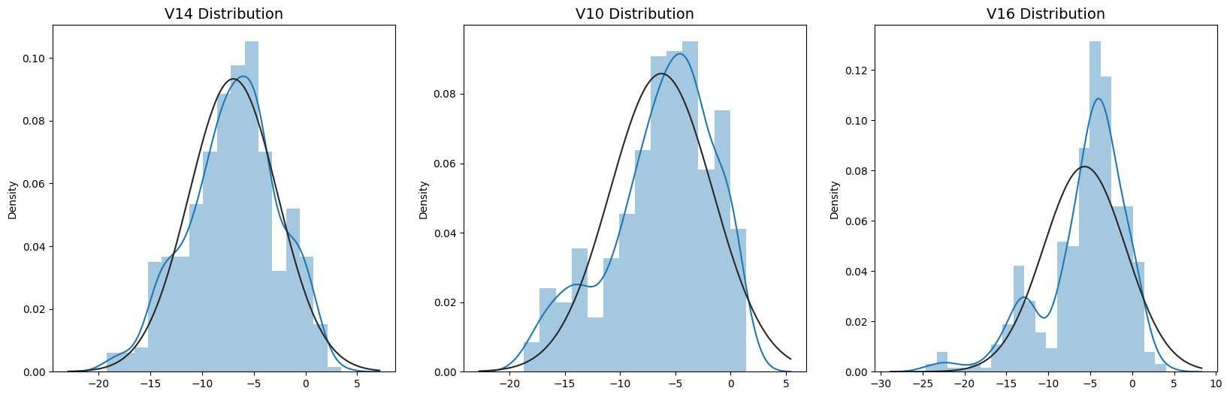
Analysis (After Preprocessing):
Distribution plot:
The distribution of the characteristic we will use to weed out some of the outliers is first visualised. Compared to features V12 and V10, only feature V14 exhibits a Gaussian distribution.

Slide 27
Analysis (After Preprocessing):
Threshold:
We will proceed to determining the upper and lower thresholds by subtracting q25 - threshold (lower extreme threshold) and adding q75 + threshold (upper extreme threshold) after choosing which value we will use to multiply with the iqr.
We have also plot the graph that shows that after doing this, the number of outliers have decreased with considerable amount.
We have also observed that our accuracy has also been increased by 3% though some outliers have distort the accuracy of out model.

Slide 28
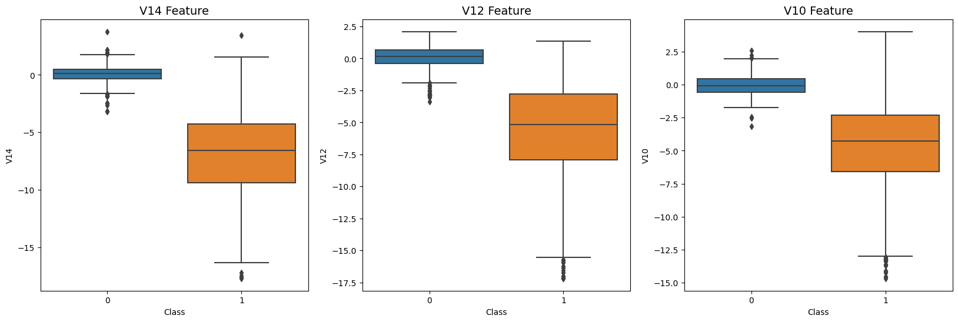

Slide 29
Analysis (After Preprocessing):
Clustering and PCA:
We have used PCA (Dimensionality Reduction) to reduce the dimension of our data and then we will use clustering to see how well our model will separate two classes(fraud and non-fraud).
We have observed that PCA can accurately cluster the classes fraud and non-fraud in our dataset. Even though subsample was pretty small.So we can also tell that further models that we will apply will also perform well.

Slide 30
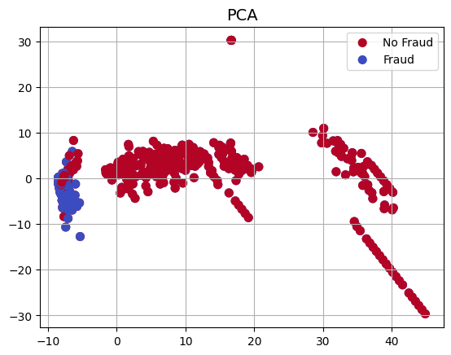

Slide 31
Model Training (Logistic Regression):
Observation:
We have observed that, our model is more likely to be overfitted (have a high variance) if there is a large difference between the training score and the cross validation score.
Our model is underfitting (high bias) if the score is low in both the training and cross-validation sets.
Logistic regression shows very good score in both training and cross-validating sets.
Following is the plot of the Learning curve of Logistic regression.

Slide 32
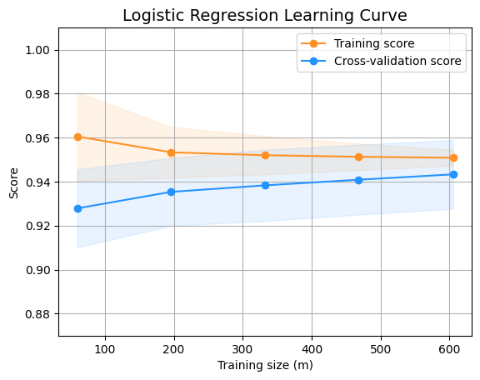

Slide 33
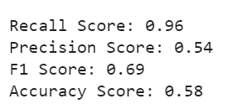
Model Training (Logistic Regression):
Precision/Recall Tradeoff:
Our model will find fewer examples as it becomes more Precise(selective). Example: Assuming that our model has a 95% accuracy rate, let's say that there are only 5 instances of fraud for which the model has an accuracy rate of 95% or higher. If we lower the precision, our model will be able to discover more cases, such as the additional 5 cases that our model believes to be 90% fraud cases.

Slide 34
ENCRYPTION PROCESS

Slide 35
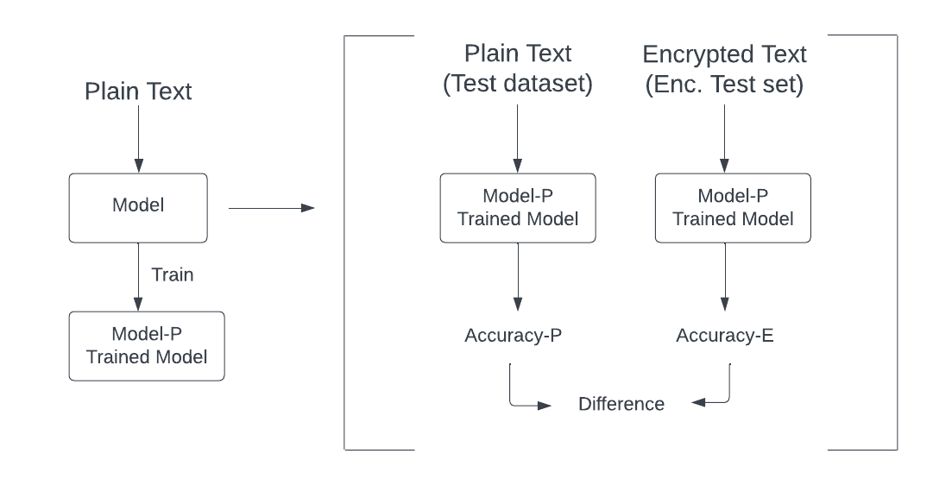
Flowchart of Model using Plain Data

Slide 36
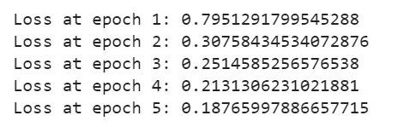
Logistic Model on Plain Train_Set
First we have trained our model on plain text 5 times using Logistic Regression & Gradient Descent.
After that we have calculated the loss at each iteration and observed that after each iteration the loss was decreasing because each time when we were getting parameters, we were using it as initial value for next iteration.

Slide 37
Then after training the model we have calculated the accuracy on plain test_set.
Now we have encrypted the test data and calculated the accuracy on cipher test_set
Difference between the accuracy of plain and cipher test_set

Slide 38
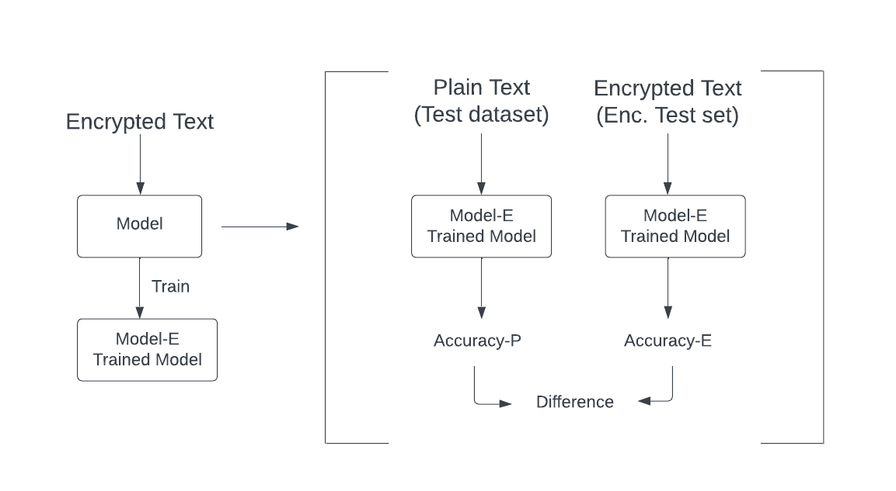
Flowchart of Model using Encrypted Data

Slide 39
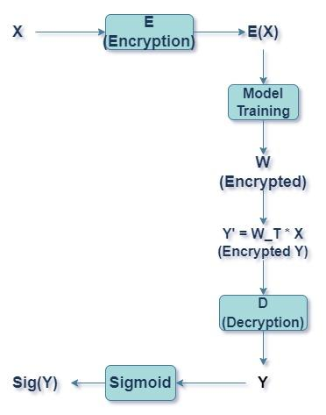
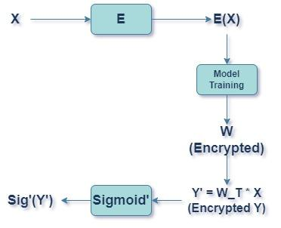
Two types of process happening in Model

Slide 40
Logistic Model on Encrypted Train_Set
Here first of all we have encrypted our train_set.
Then we have trained our model on cipher train_set 5 times using Logistic Regression & Gradient Descent.
After getting the optimal parameter values we have calculated the accuracy of cipher test_set using different sigmoid function and then using the parameters we have predicted the class on plain test_set and decrypted the result because those are encrypted results
And after decrypting the result we have calculated the accuracy and found the difference between the accuracies

Slide 41
Contribution
Jay Patel: Analysis of encryption scheme, Implementation of code, Creating PPT, Report and Video.
Chaudhari Vraj: Analysis on Dataset, Implementation of code, Creating PPT, Report and Video.
Shreyansh Kunjera: Analysis on Dataset, Implementation of code, Creating PPT, Report and Video.
Meet Bhatt: Gathering the information related to our encryption scheme, Creating SRS

Slide 42
References
https://lucid.app

Slide 43
Thank You

